Slide 1


A1: Engaging AI in Aviation Meteorological Information Dissemination System (AMIDS) for Enhanced User Experience
AMIDS COMPASS
Presenter: Daehee KANG
Supervisor: Jennifer yip

Slide 2
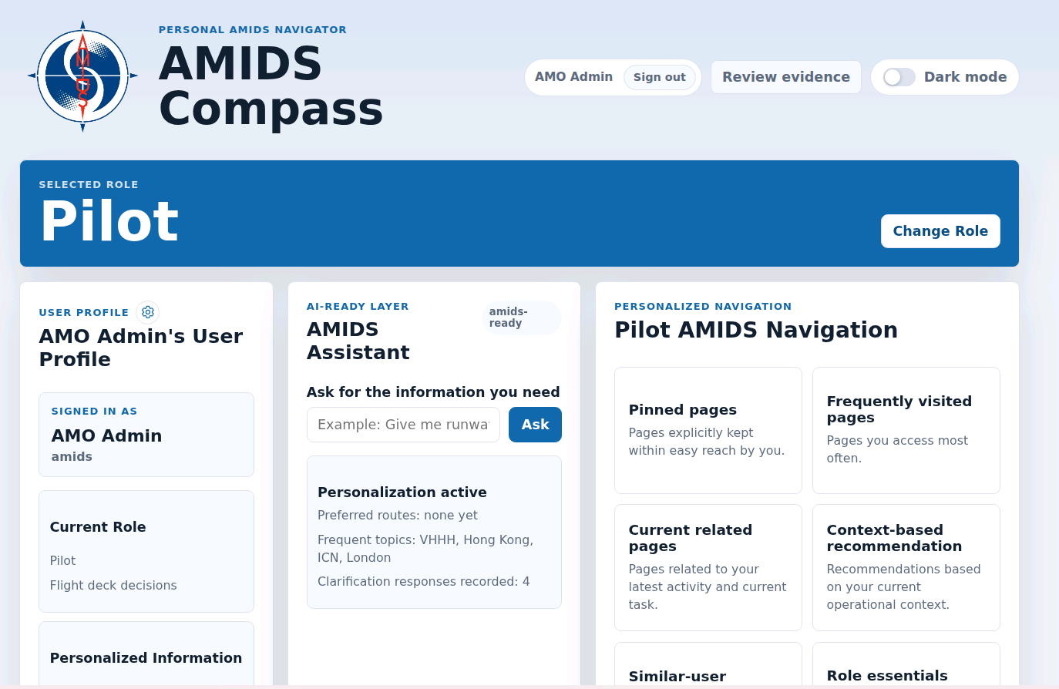
Presentation Agenda
CONTENTS
Context and System Shape
Why AMIDS Compass exists, what it includes, and how the local-first architecture is organized.
2. Controlled Page Foundation
How the route registry and dynamic resolver keep page opening approved, parameterized, and auditable.
3. Model Development
The core technology: lexical ranking, semantic matching, arbitration, and the data pipeline around them.
4. Personalization & Runtime Context
How the app adapts through profiles, route memory, similar-user signals and scraped data
5. Dynamic webpage handling
Problems this project resolves, what the future is, and what the work demonstrates.

Slide 3
Section 01
Context and System Shape
Why AMIDS Compass exists, what it includes, and how the local-first architecture is organized.
AMIDS Compass

Slide 4
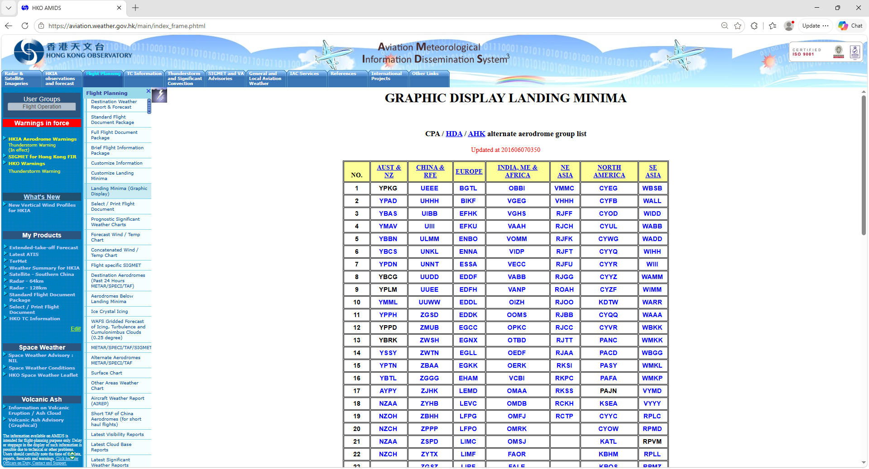
INTRODUCTION TO AMIDS
What is AMIDS?
AMIDS = Aviation Meteorological Information Dissemination System
The Main Stakeholders: Registered Aviation Users In Hong Kong (Pilots, ATCs, Dispatchers, AMO / MRO)
Usual purposes: flight planning, flight documentation, self-briefing, etc.
Available information: various weather reports & forecasts, significant weather warnings, etc.

Slide 5
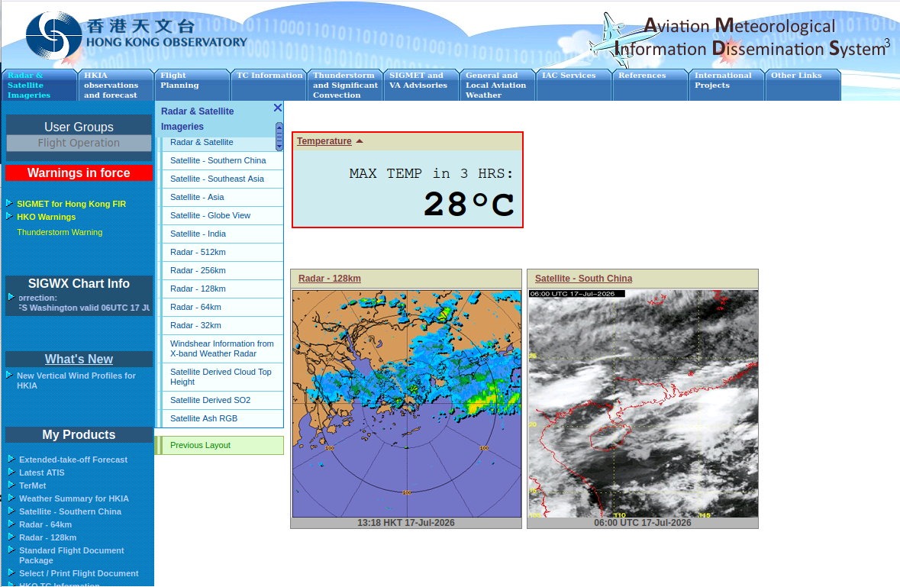
WHAT CAN AMIDS COMPASS IMPROVE?
Points of improvement
Faster access to scattered pages
Memory dependency lowered through smart navigation assistant
Smoother handling of dynamic web pages
Open dynamic pages with wanted settings automatically applied
Personalized categorization to fit all users
Dynamically categorize pages according to user’s interaction with the app
Shifting to a reusable app architecture
A React + Node.js app that is scalable & easily renovated
Information dissemination to user-based info
Providing all available information at once → providing information specific to users

Slide 6

INTRODUCTION
What is AMIDS Compass?
A layer of application that lies between operational users and approved AMIDS pages to guide users like a compass.
1
User intent
2
Page decision
3
Dynamic resolution
4
Opened workspace
A short query, profile settings, or button press.
>
AMIDS Compass selects approved registry page IDs that best matches user’s needs
>
Runway, airport, airline, route, or time is filled safely.
>
One page, a grouped page set, or clarification.
AMIDS Compass is a personalized assistant for efficiently navigating AMIDS
AMIDS Compass
04

Slide 7
EXAMPLE APP USAGE FLOW
Video Demo
1
>
2
Select your role
>
Ask
>
>
>
Sign up / Sign in
3
4
Match
5
Resolve
6
Open
07

Slide 8
NAVIGATION TOOLS & BASIC FUNCTIONALITIES
What personalized navigation tools are there?
The app gives alternatives for people who do not want to rely only on chat.
AMIDS Compass
It understands what kind of aviation weather information the user is asking for.It matches that request to approved AMIDS pages.It opens the correct page, or multiple related pages, in a controlled workspace.It learns from user habits, pinned pages, repeated choices, and profile settings to make future navigation faster.
User profile
Ask for information
Pinned pages
prognostic chart
Ask
Frequently visited
Prognostic SIGWX Charts
Context
Selected page with dynamic code
Similar users
Forecast Wind/Temp Chart
Alternative suggestion
Satellite TC Track Overlay
Alternative suggestion
AMIDS Compass
06

Slide 9
THE ARCHITECTURE
Local-first orchestration: The Architecture
React handles the user experience; local services validate, resolve, rank, record, and scrape.
React UI
Node gateway
Ranker API
Resolver
AMIDS pages
Ask, pin, review,
open page sets
>
Auth, validation,
page opening events
>
Lexical + semantic
page matching
>
Static paths +
dynamic templates
>
Embedded or
external opening
Supporting services
PostgreSQL stores profiles and evidence, the scraper worker adds live data sources and the Ollama local API remains optional for generation, experimentation and potential fallback.

Slide 10
Section 02
Controlled Page Foundation
How the route registry and dynamic resolver keep page opening approved, parameterized, and auditable.
AMIDS Compass

Slide 11
THE REGISTRY
The Route Registry became the control point
Every model or UI decision must resolve to approved page IDs and authoritative paths. Internally, route = AMIDS page
Keyword convention
Required page structure example:
{
"id": "destination-weather-report-forecast", "title": "Destination Weather Report & Forecast",
"path": "https://aviation.weather.gov.hk/cgi-bin/metcond/...”
"description": "Weather reports and forecasts for destination aerodromes",
"keywords": [
"topic:destination weather",
…
"purpose:bulletin-feed",
"route:destination weather report forecast",
"destination metar",
…
"destination speci",
"flight destination weather"
]
},
topic: shared concepts for grouping
purpose: how information is presented
route: page name and close aliases
plain keywords: operational phrases
runtime keywords: terms scraped from live pages
This keeps AI behavior controlled: the model can suggest IDs, but the app opens only approved registry paths.

Slide 12
DYNAMIC PAGES HANDLING
Dynamic URLs were separated from route selection
The route decides the page; the resolver decides the page state only when dynamic keywords are present or safely inferred.
1
Select approved page
Examples now handled
The selected route ID comes from the registry, button, user memory, or model result.
Runway reports
Satellite areas
Radar animation/overlay
Landing minima
Flight packages
Forecast wind/temp charts
2
Extract or infer parameters
Runway, area, airline, aerodrome, route code, chart type, and flight package fields are resolved.
3
Clarify only when needed
High-risk identity parameters ask the user; safe display settings use defaults or profile values.

Slide 13
Section 03
Model Development
The core technology: lexical ranking, semantic matching, arbitration, and the data pipeline around them.
AMIDS Compass

Slide 14
MODEL FOCUS
Most effort went into the local navigation engine
The project shifted from simply calling an LLM to making fast, controlled page decisions locally.
Early Ollama LLM routing
Good semantic flexibility, but slow and inconsistent on local hardware.
Deterministic shortcuts
Fast, but risked hard-coding too much of the intended AI behavior.
PyTorch lexical ranker
Instant local inference, but sensitive to training data quality and wording coverage.
Semantic encoder
Better zero/few-training baseline for meaning, but needs careful scope and arbitration logic.
Current direction
Use semantic + lexical evidence as inputs to a controlled decision layer.

Slide 15
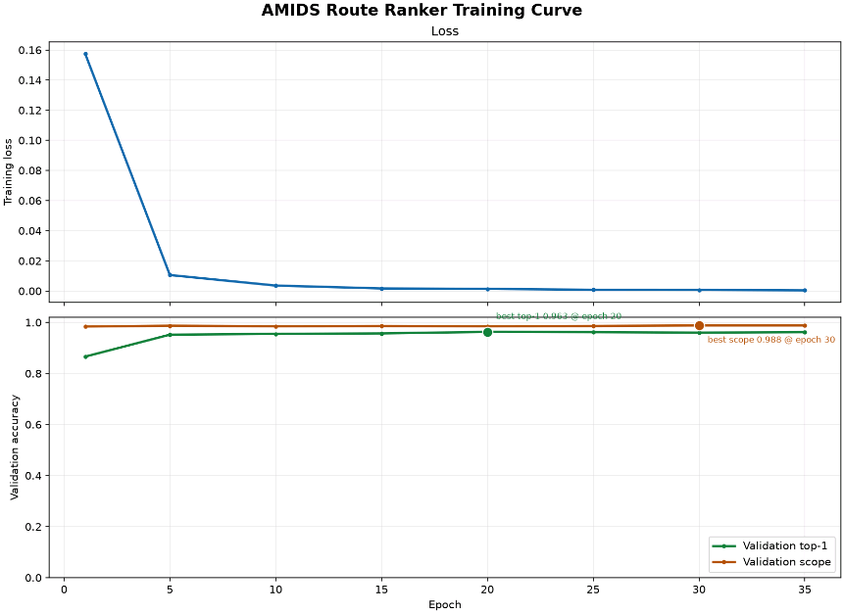

Slide 16
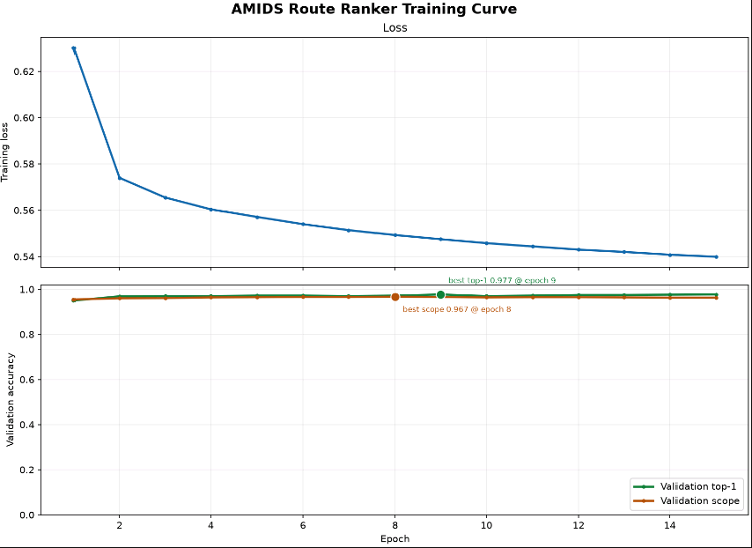

Slide 17
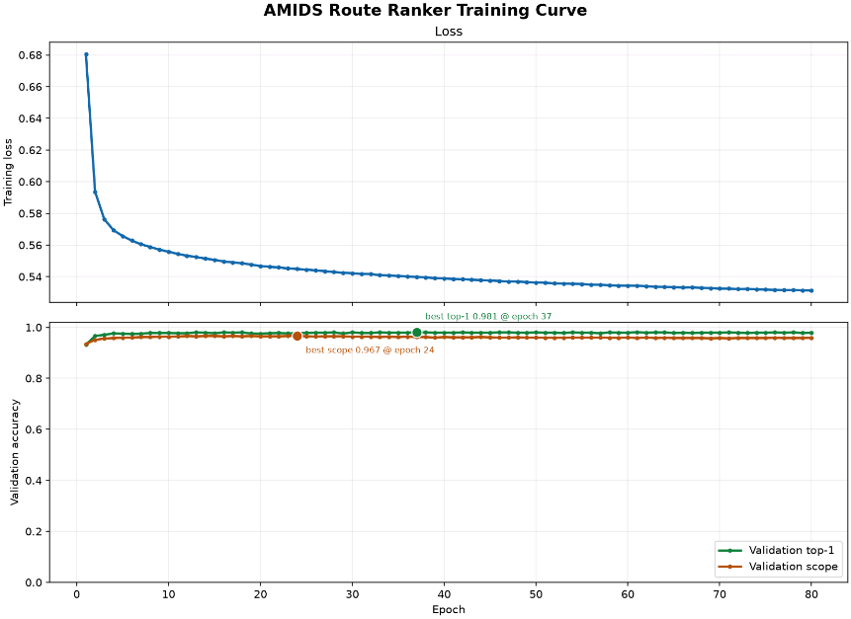

Slide 18
LEXICAL RANKER
The first custom model learned query-page matching locally
It was designed to be fast, trainable, auditable, and independent from cloud services.
Input features
Model architecture
Scope head
Queries and pages are normalized into word unigrams, bigrams, and 3-/4-character features, then BLAKE2-hashed into fixed vectors.
Separate query and page projections compare [query, page, absolute difference, feature product], then score relevance.
A query-only branch predicts single versus multiple-page intent, later separated from role context to reduce leakage.
Important learning
The model became very fast, but overfitting showed that dataset diversity and held-out realism matter more than simply increasing epoch count.

Slide 19
SEMANTIC ENCODER
Semantic matching became the practical low-training baseline
A prepared local MiniLM sentence encoder compares user wording with page metadata and keywords.
1
Encode the query
Preprocessing expands common aviation shorthand and typo-prone terms before embedding.
Why this mattered
Encode page metadata
It gave a functioning route decider without waiting for enough expert training data to make the lexical model fully robust.
2
Titles, descriptions, keyword groups, and dynamic supported terms become comparable page text.
3
Compare cosine similarities
Top score, margin, cluster shape, and explicit scope cues guide single vs multiple suggestions.

Slide 20
DYNAMIC PAGES
Dynamic URLs are resolved without expanding the registry
One page can represent many valid parameter states.
Family
Examples
Resolution rules
Flight packages
Flight number, destination, or route code.
Use static path unless dynamic intent is detected.
Radar pages
Range, animation, and overlay.
Ask only for crucial identity parameters.
Satellite pages
Region, view type, and TC overlays.
Default low-risk display settings.
Group related dynamic page families.
Reports & charts
OPMET, minima, SIGWX, wind/temp, volcanic ash.
Result: flexible links without an unmanageable registry.
AMIDS Compass technical report
09

Slide 21
ARBITRATION
The decision layer became as important as the model
Raw lexical scores and semantic similarities are not directly comparable, so the app now separates evidence from confidence-to-act.
Lexical evidence
Semantic evidence
Arbitrated action
Strong when trained wording matches page metadata; risky when it becomes overconfident on narrow patterns.
Useful for meaning and synonyms; weaker when many related pages cluster close together.
Open when evidence is clear; suggest/clarify when models disagree, scope is unclear, or dynamic info is missing.
Final design choice
Use model outputs as evidence sources. The final product decision can still be clarification, grouped suggestions, dynamic-param prompts, or personalized shortcut opening.
AMIDS Compass technical report
14

Slide 22
TRAINING DATA
The model pipeline became a product in its own right
A large part of the work is generating, validating, reviewing, evaluating, and promoting data safely. It is repeatable!
1
Registry export
4
Hard examples
Freeze approved page metadata.
Failure cases routed to review.
2
Generated data
5
Held-out tests
Balanced template variants, typos, scopes.
Frozen evaluation data, not training data.
3
Synthetic expert seeds
6
Promotion
LLM-written queries with fixed labels.
Compare, approve, roll back.
Key lesson: more examples only help when they add genuinely different wording and trustworthy labels.
AMIDS Compass technical report
15

Slide 23
Section 04
Personalization & Runtime Context
How the app adapts through profiles, route memory, similar-user signals and scraped data
AMIDS Compass

Slide 24
PERSONALIZATION
Personalization is bounded, not blind model retraining
The app improves individual workflow speed without pretending the global model has become more certain.
Profile-to-param
Personal route memory
Similar-user signal
Explicit query values outrank recent/session values, which outrank profile values, safe defaults, and clarification.
If a user repeatedly chooses the same page for similar wording, the app can bypass clarification for that user.
Backend route events can surface pages used by users with overlapping behavior, while remaining explainable to admins.
Safety boundary
Personalization creates shortcuts and suggestions; it does not silently rewrite approved URLs or inflate model confidence globally.

Slide 25
SCRAPING AND RUNTIME DATA
The scraper turns changing page content into usable context
This matters most for dynamic information that cannot be fully represented by a static registry.
Flight package lookup
Certificate-protected pages
Runtime keywords
Scraped flight options allow users to type a flight number and let the app fill matching IATA and departure time.
The workable path was Playwright-bundled Chromium with manual login and CDP attach to reuse the authenticated browser session.
Scraped terms such as tropical cyclone names can temporarily improve page matching and grouping.
This expands Compass from static navigation into context-aware navigation, while keeping the scraper output separate from the approved route registry.

Slide 26
GOVERNANCE
Admins see the decision processes; normal users do not
Operational simplicity for users, detailed diagnostics for developers/admins.
Normal user view
Admin/developer view
Ask questions
Open suggested pages
Use pinned/grouped controls
Fill dynamic details
No scores or diagnostics
Review interaction evidence
Inspect lexical/semantic ranking
Search and approve corrections
Check scraper status
Tune thresholds and datasets
The improvement loop is visible to the people tuning the system, but hidden from people who only need the right page quickly.

Slide 27
Section 05
Reflection
Problems this project resolves, what the future is, and what the work demonstrates.
AMIDS Compass

Slide 28
What this project resolved
What remains open
Approved-page navigation is now controlled by a registry.
Model reliability still depends heavily on metadata and data quality.
Static, dynamic, and multi-page openings are working as one flow.
Dynamic parameter understanding is partly deterministic for now.
A local model pipeline and review loop now exist.
Certificate-protected scraping needs production governance.
Personalization is bounded through profiles, events, pins, and memory.
Real expert review is still the main bottleneck for validation.
Conclusion
AMIDS Compass shows that operational navigation can become faster and more personal without giving up control, auditability, or local deployment.

Slide 29
Acknowledgement
I would like to express my sincere gratitude to the A1 Team for their continuous endeavor, guide and support throughout this project. It has been invaluable to me throughout this journey, thank you.

Slide 30
Thank you for listening
Ask me any questions!
AMIDS Compass

